Slide 1





Fraud Analysis
PaySim Data
PaySim simulates mobile money transactions using real financial logs from an African service for one month. The dataset, scaled down to 1/4 of the original, is synthetic and created for Kaggle, provided by a multinational financial service operating in over 14 countries.

Slide 2

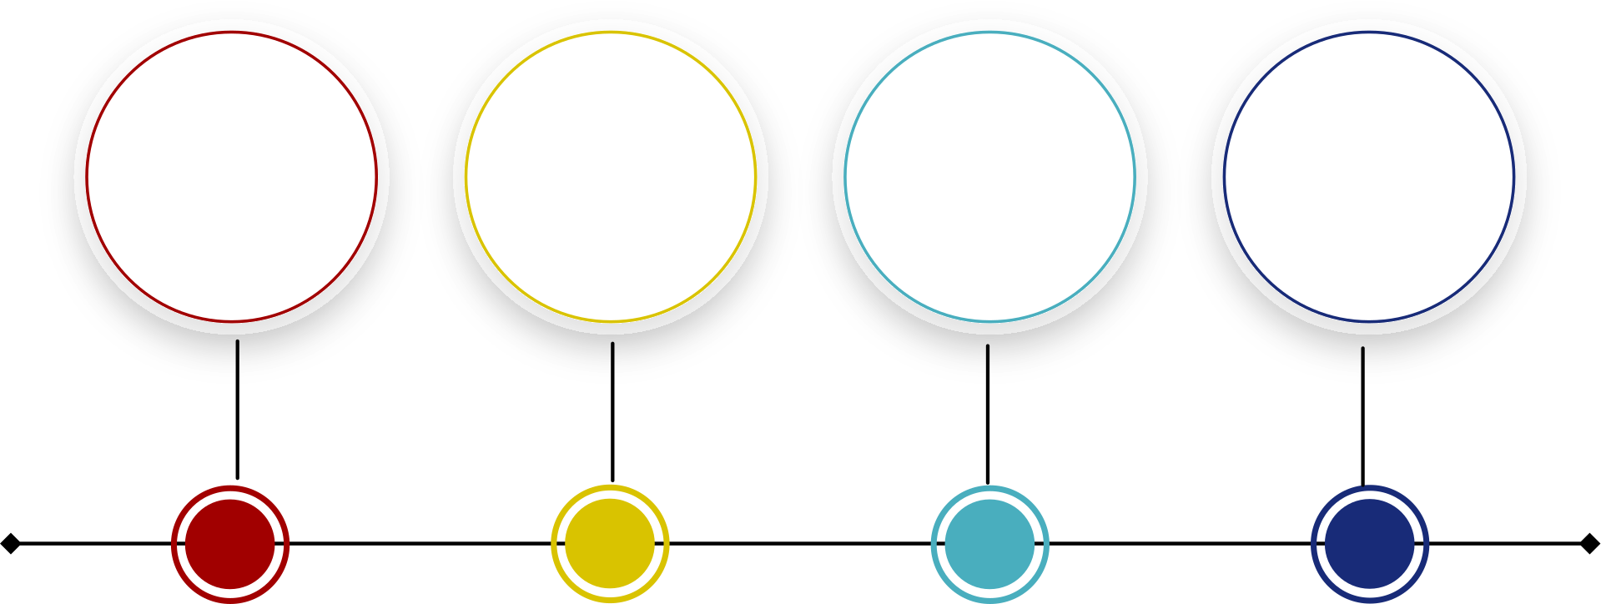
Project Overview
Tableau
Hypothesis
Test
Challenges
ML

Slide 3
Hypothesis Test
“Analyzing the Association Between Mapped Transaction Amount Categories and Fraudulence”
“The mean transaction amounts for fraudulent and non-fraudulent transactions are significantly different”
“There is a significant difference in the mean transaction amounts across the different categories”
Chi-Square Test
T-Test
Anova Test
Null Hypothesis Rejected
Null Hypothesis Rejected
Null Hypothesis Rejected

Slide 4
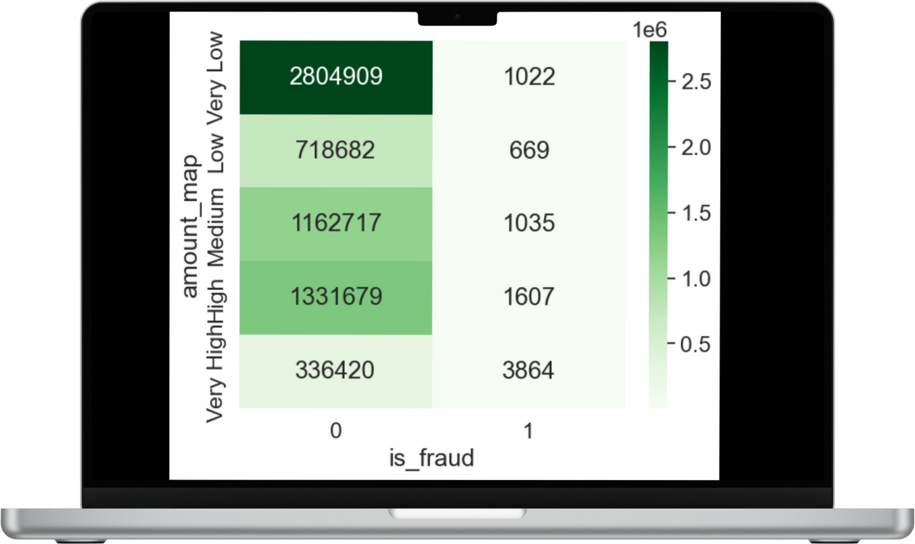

Hypothesis Test Results
Analyzing the Association Between Mapped Transaction Amount Categories and Fraudulence
1
Chi-Square tests are specifically designed for testing associations between two categorical variables.
2
Comparing observed frequencies in each category pair to the frequencies we would expect if the variables were independent.
3
Since p-value < 0.05, we reject the null hypothesis (H₀).
There is a statistically significant association between amount_map and is_fraud.
4
Strength of association using Cramér's V: Value: 0.067. The association between the variables is weak.

Slide 5
Hypothesis Test
“Analyzing the Association Between Mapped Transaction Amount Categories and Fraudulence”
“The mean transaction amounts for fraudulent and non-fraudulent transactions are significantly different”
“There is a significant difference in the mean transaction amounts across the different categories”
Chi-Square Test
T-Test
Anova Test
Null Hypothesis Rejected
Null Hypothesis Rejected
Null Hypothesis Rejected

Slide 6
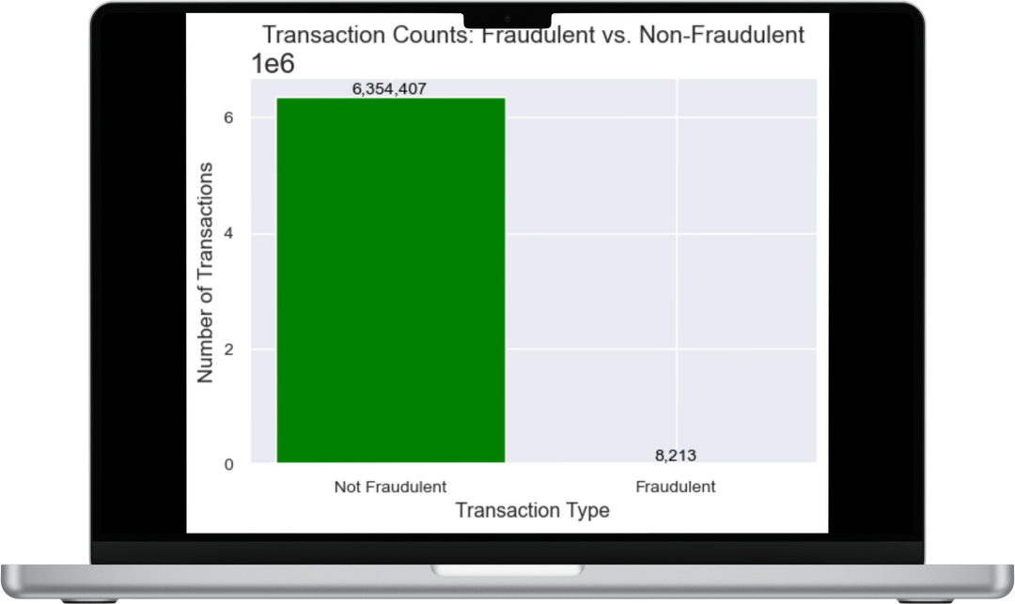
Hypothesis Test Results
Analysing Transaction Amounts: Fraudulent vs. Non-Fraudulent
1
Initial Approach: Two-tailed t-test to compare means.
T-Statistic: 194.01
P-value: < 0.00
Conclusion: Significant difference in mean transaction amounts.
2
Assumption Checks:
Normality (Shapiro-Wilk Test):
Fraudulent: p< 0.05(Not Normal)
Non-Fraudulent: p<0.05 (Not Normal)
Equal Variances (Levene’s Test):
p=0.0: Variances are not equal.
3
Non-Parametric Approach
Mann-Whitney U Test:
P-value: p=0.0
Conclusion: Significant difference in transaction amount distributions

Slide 7
Hypothesis Test
“Analyzing the Association Between Mapped Transaction Amount Categories and Fraudulence”
“The mean transaction amounts for fraudulent and non-fraudulent transactions are significantly different”
“There is a significant difference in the mean transaction amounts across the different categories”
Chi-Square Test
T-Test
Anova Test
Null Hypothesis Rejected
Null Hypothesis Rejected
Null Hypothesis Rejected

Slide 8
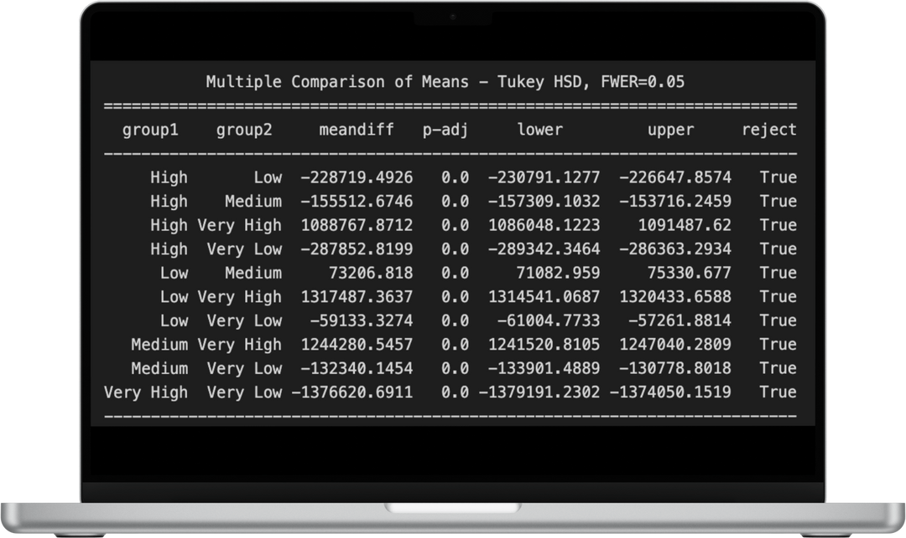
Hypothesis Test Results
Transaction Amounts Across Categories
1
One-Way ANOVA Test:
To test if there is a significant difference in mean transaction amounts across amount_map categories.
Results:
F-Statistic: 561,557.75
P-Value: 0.0
Conclusion: There is a significant difference in mean transaction amounts across categories.

Slide 9

ML Models
Logistic Regression
Decision Tree Classifier
Linear Discriminant Analysis
Gaussian NB
Support Vector Machine
KNeighbors Classifier

Slide 10

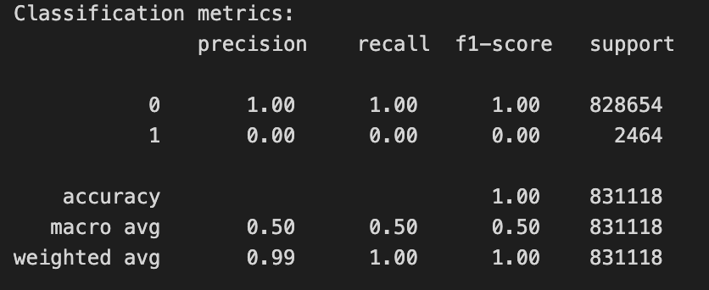


UNDER-SAMPLING
Imbalanced Data
Logistic regression

Slide 11
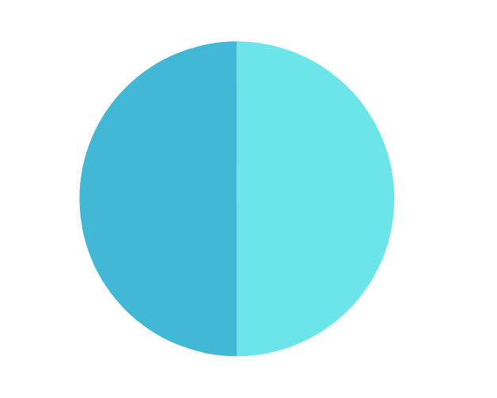
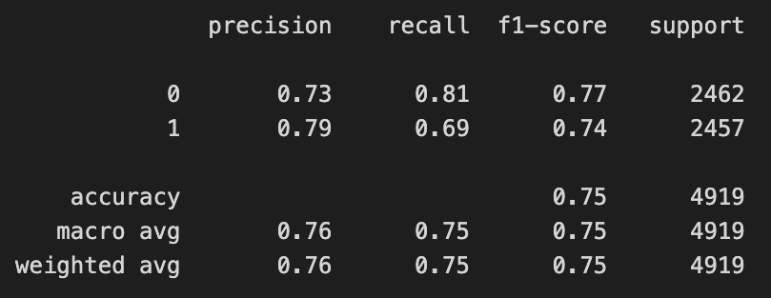
UNDER-SAMPLING
Imbalanced Data
Logistic regression

Slide 12

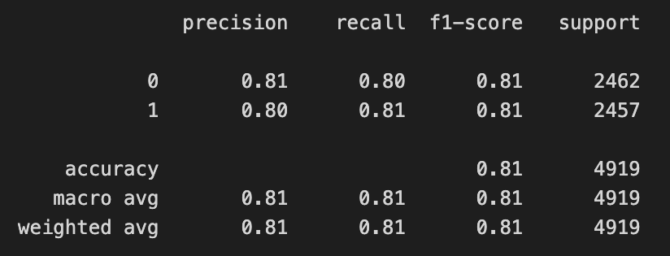
Decision Tree Classifier
Decision Tree Classifier is a tree-based model used for classification or regression. It splits data into subsets based on feature conditions, making it easy to interpret. While it handles non-linear relationships well and requires no scaling.
Next

Slide 13

Thank You For Watching

